Slide 1

PREDICT PRICE DIVERGENCE IN
DAY AHEAD MARKET (DAM) VS
HOUR AHEAD MARKET (HAM)
analytics
MANUEL CORREA
manuelcorrea198@gmail.com

Slide 2

presentation outline
Introduction
Datasets
LMP - CAISO
ISD Station History
CAISO Nodes
Feature Engineering
Building the model
Model Evaluation
Conclusions

Slide 3
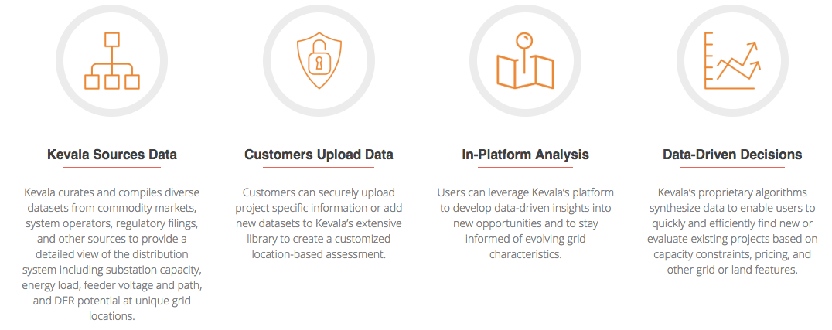
introduction
kevala analytics
Provides data-driven insights for an evolving energy market

Slide 4
Project: PREDICT PRICE DIVERGENCE IN DAM VS HAM
kevala analytics
INPUTS
Historic Day Ahead prices
Historic Hour Ahead prices
Historic weather data (temperature, visibility, wind)
OUTPUT
Forecast divergence between DAM and HAM
Forecast price anomalies, such as prices will cross certain thresholds.

Slide 5
presentation outline
Introduction
Datasets
LMP - CAISO
ISD Station History
CAISO Nodes
Feature Engineering
Building the model
Model Evaluation
Conclusions

Slide 6

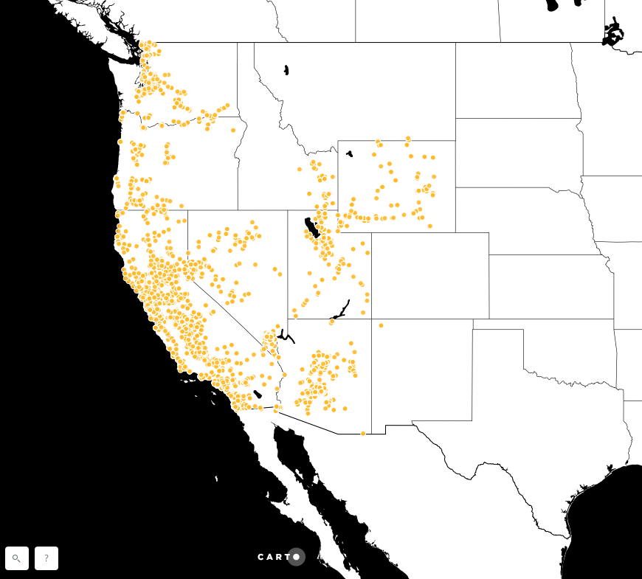
DATASETS
kevala analytics
CAISO Nodes
(power station)

Slide 7

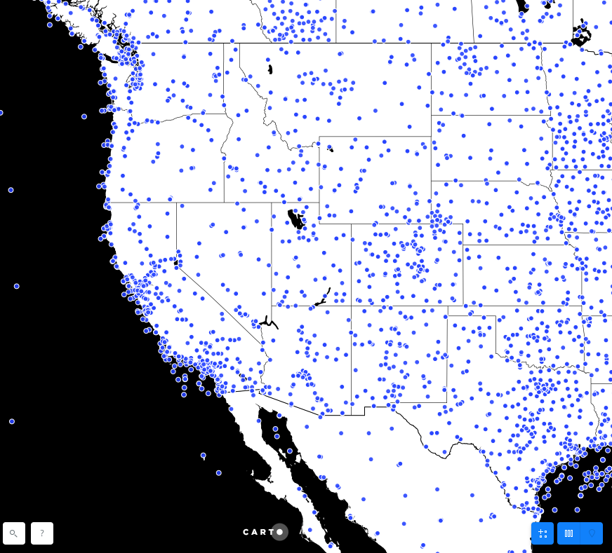
DATASETS
kevala analytics
ISD History
(weather stations)

Slide 8
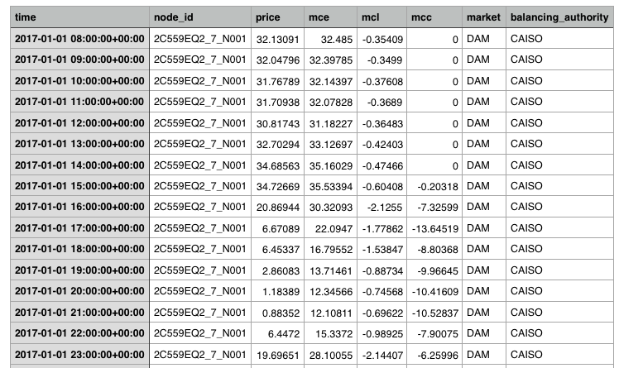
DATASETS
kevala analytics
LMP (local marginal prices)

Slide 9
presentation outline
Introduction
Datasets
LMP - CAISO
ISD Station History
CAISO Nodes
Feature Engineering
Building the model
Model Evaluation
Conclusions

Slide 10
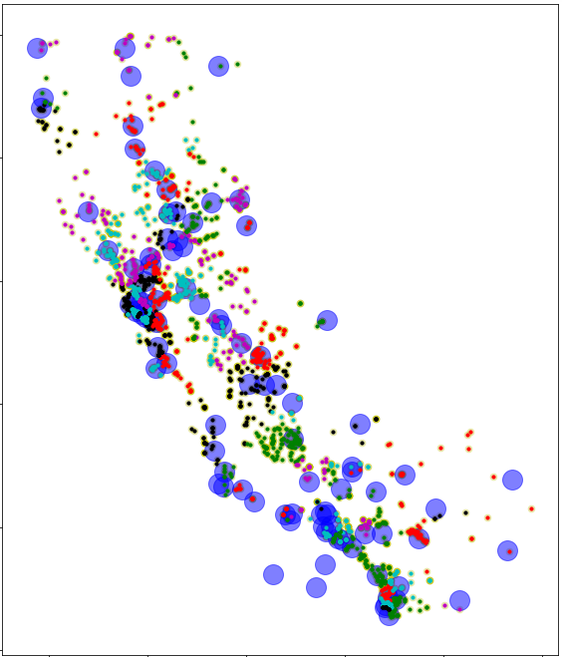
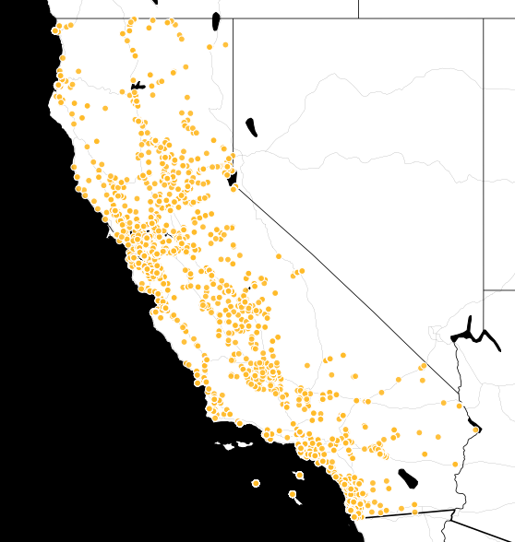
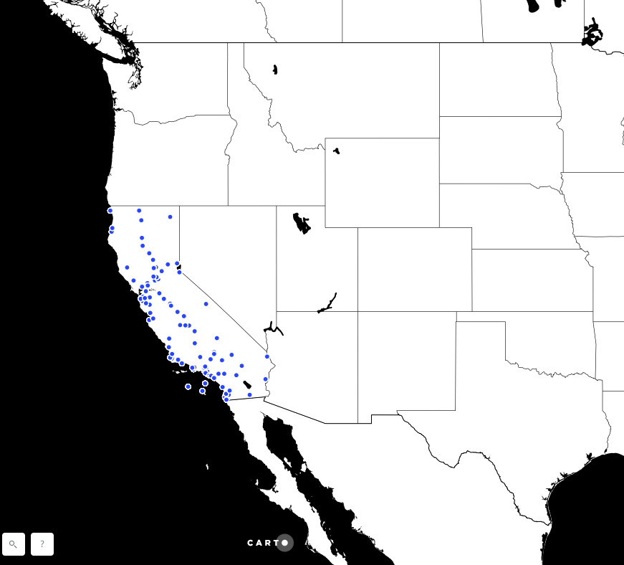
FE
kevala analytics
CAISO Nodes
Weather stations
Closest by distance

Slide 11
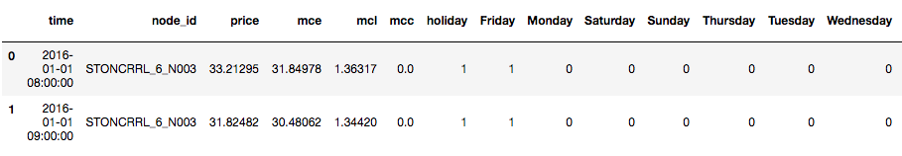
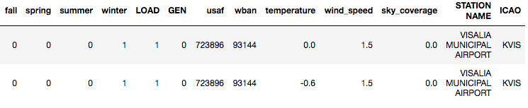
FE
kevala analytics
LMP (local marginal prices)
2016-2017
DAM
HAM

Slide 12
presentation outline
Introduction
Datasets
LMP - CAISO
ISD Station History
CAISO Nodes
Feature Engineering
Building the model
Model Evaluation
Conclusions

Slide 13
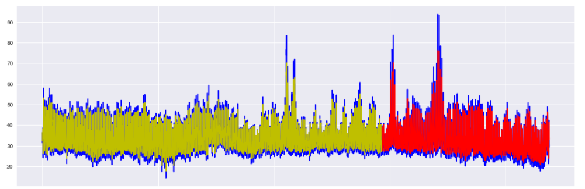
Building the model -1
kevala analytics
Prices only

Slide 14
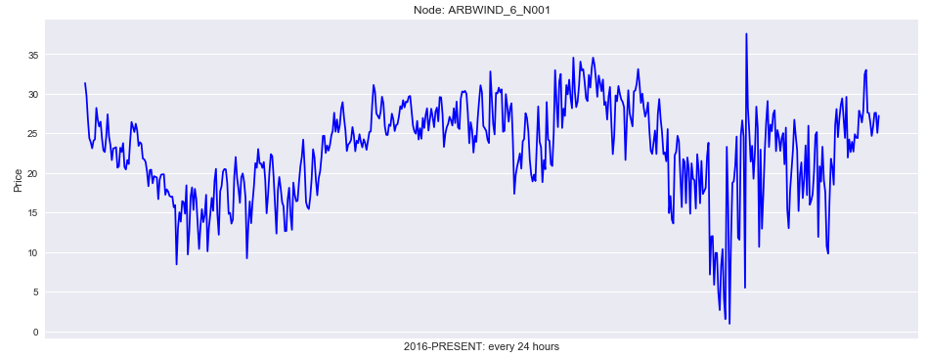
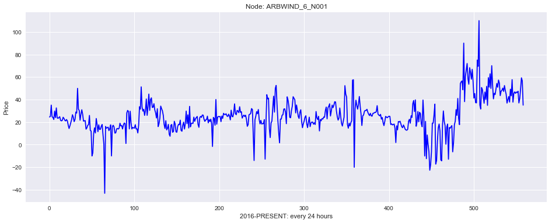
Building the model -2
kevala analytics
Selecting Nodes
DAM
HAM

Slide 15
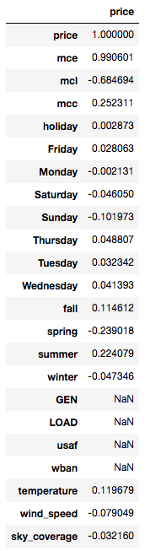
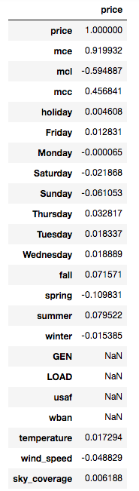
Building the model -2
kevala analytics
DAM
HAM
Selecting features
fillna

Slide 16

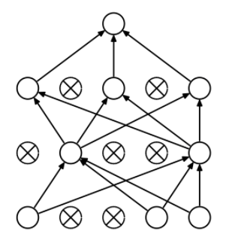
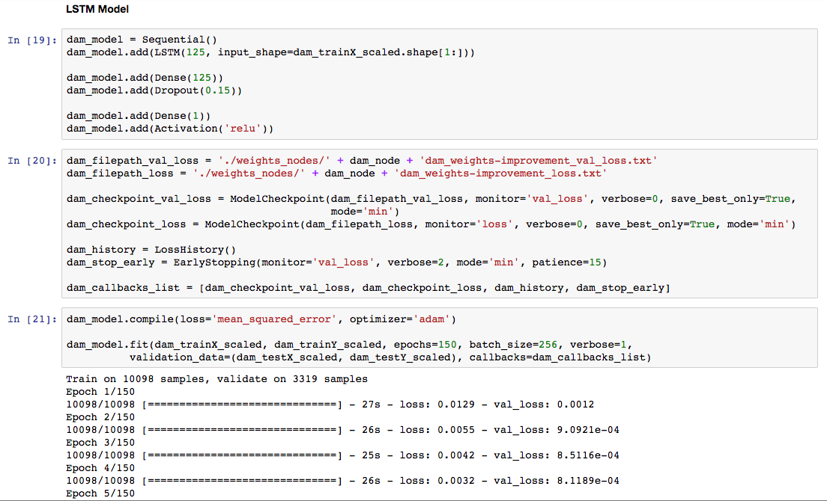
Building the model -3
kevala analytics
LSTM

Slide 17
presentation outline
Introduction
Datasets
LMP - CAISO
ISD Station History
CAISO Nodes
Feature Engineering
Building the model
Model Evaluation
Conclusions

Slide 18
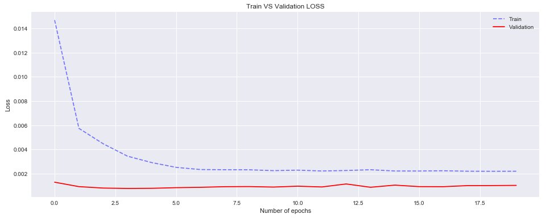
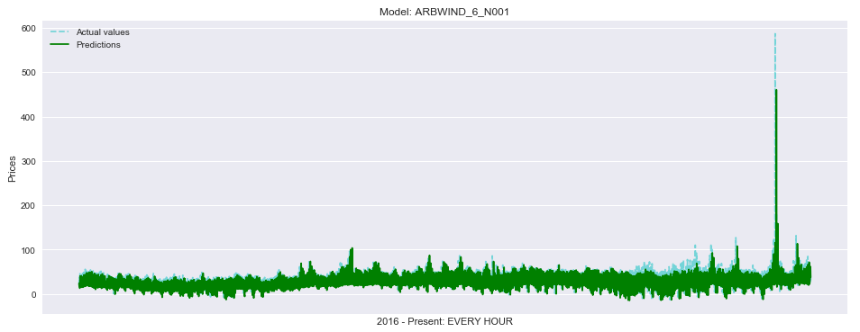
Evaluating the model
kevala analytics
DAM

Slide 19
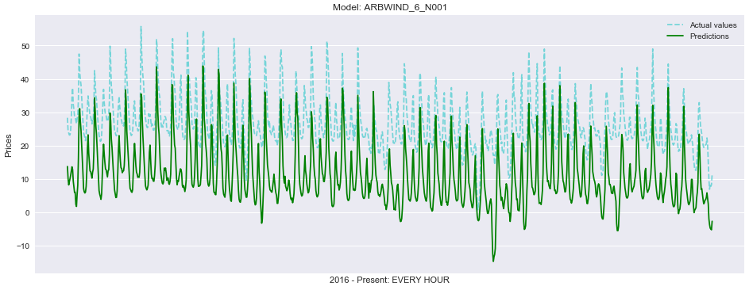
Evaluating the model
kevala analytics
DAM

Slide 20
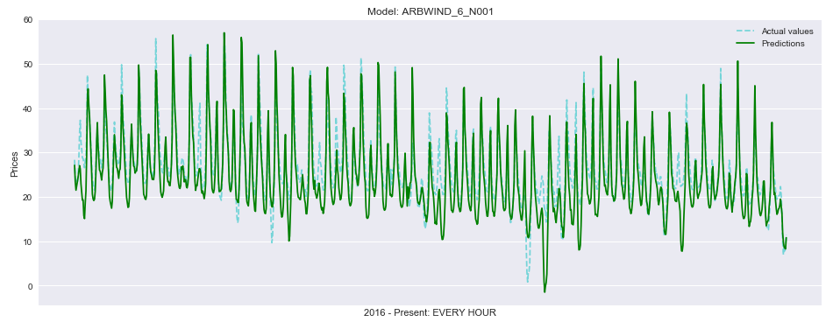
Evaluating the model
kevala analytics
DAM

Slide 21
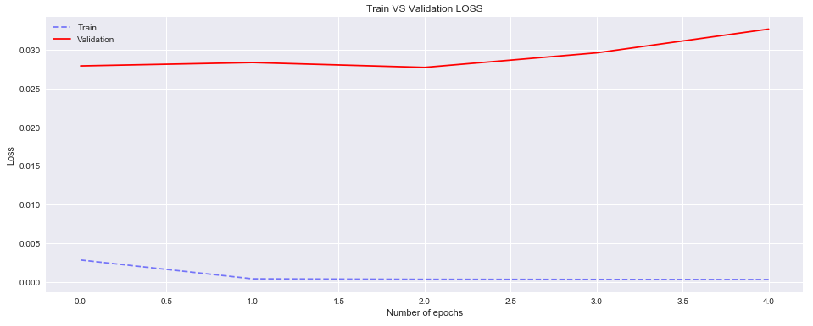
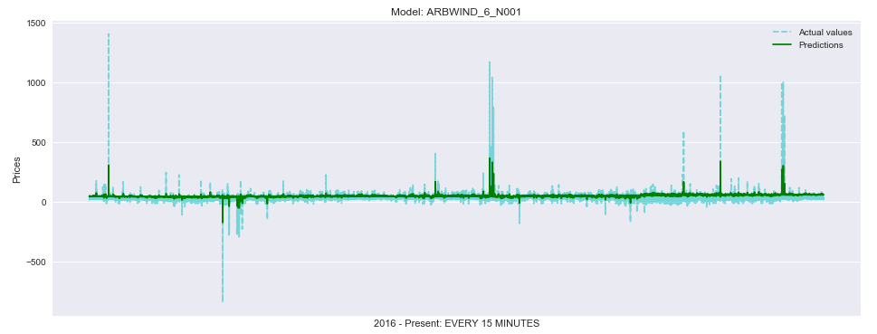
Evaluating the model
kevala analytics
HAM

Slide 22
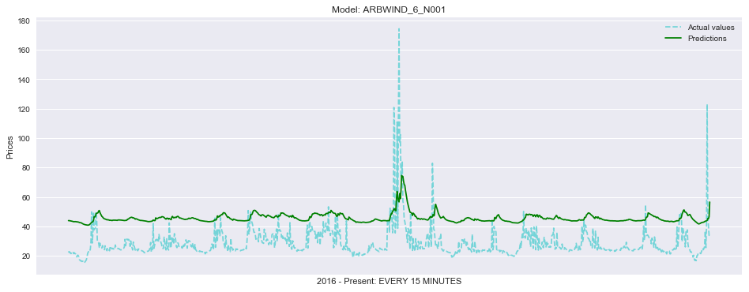
Evaluating the model
kevala analytics
HAM

Slide 23
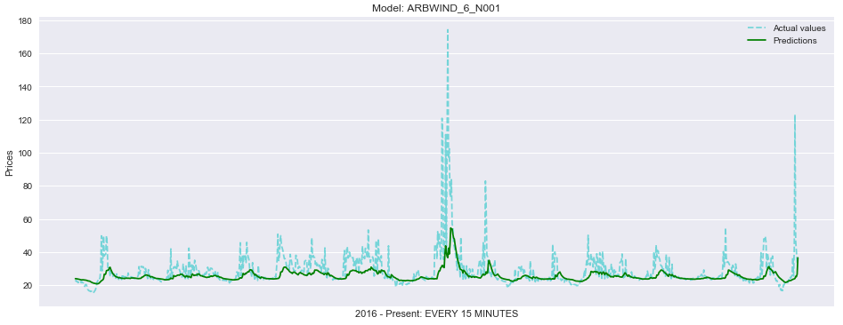
Evaluating the model
kevala analytics
HAM

Slide 24
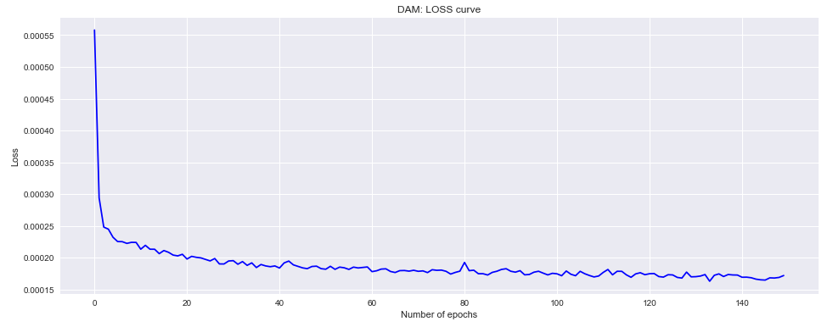
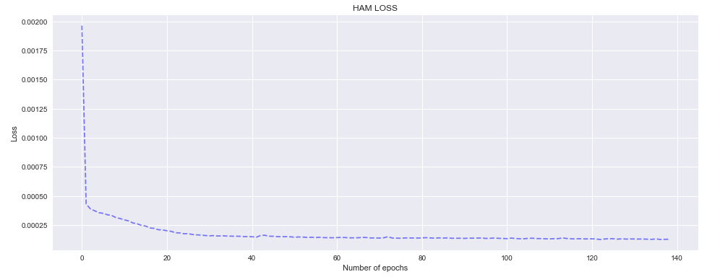
forecasting
kevala analytics
DAM vs HAM

Slide 25
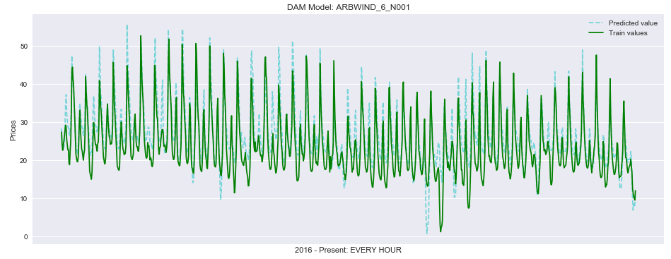
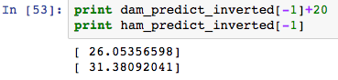
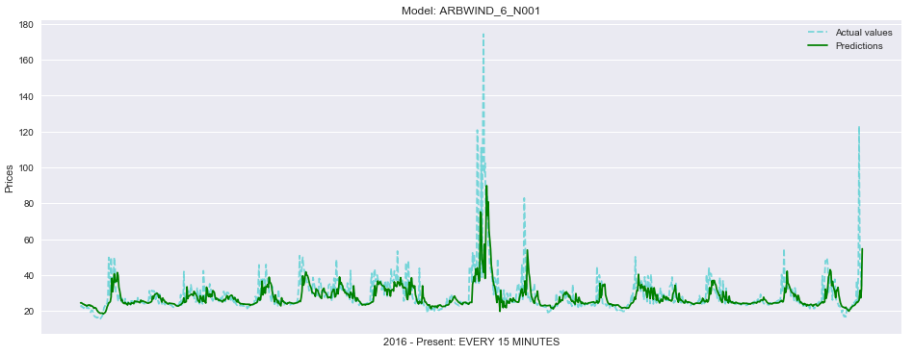
Divergence forecasting
kevala analytics

Slide 26
presentation outline
Introduction
Datasets
LMP - CAISO
ISD Station History
CAISO Nodes
Feature Engineering
Building the model
Model Evaluation
Conclusions

Slide 27

conclusions
kevala analytics
Improve model
Add more complete features
Weather
Demand
Prices of fuels/generators

Slide 28
Q&A

Slide 29


